Slide 1
Preparing to Study Units 3 and 4 English
What do you need to know for a successful experience?

Slide 2
Outcomes and Content for Unit 3
Outcome One: Reading and Creating Texts
Study two texts, Nine Days (Toni Jordan)– Text response essay, Like a House on Fire (Cate Kennedy)- Creative response.
Common ideas and themes: family/relationships, overcoming difficulties, challenging social norms.
You are expected to read these texts before we commence studies next year.
Outcome Two: Analysing Argument
You will read and view different persuasive texts.
We will identify arguments and analyse how language is used to persuade an audience.

Slide 3
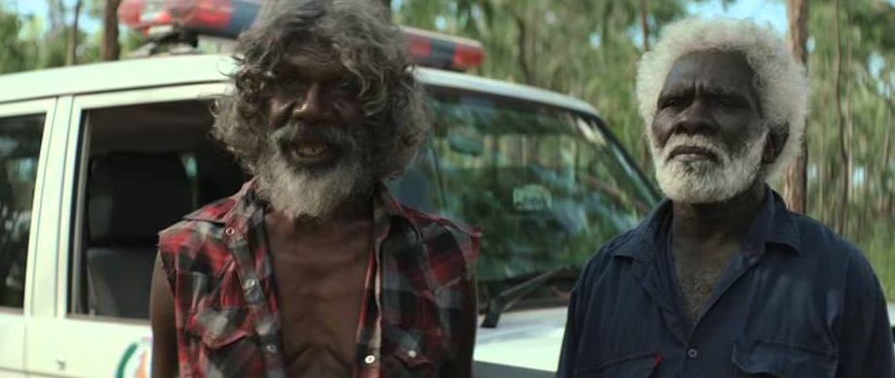
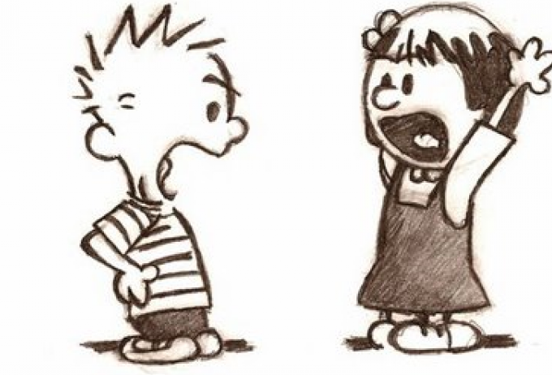
Outcomes and Content for Unit 4
Outcome One: Reading and Comparing Texts
Read the memoir The Hate Race and view the film Charlie’s Country.
Compare key ideas, themes and issues and how they texts explore these.
Outcome Two: Presenting Argument
Present a point of view in oral form about a current issue debated in the Australian media (4-6 minutes).

Slide 4
Texts
We are studying the texts in this order:
Unit 3
Nine Days, Toni Jordan (novel)
Like a House on Fire, Cate Kennedy (short stories)
Unit 4
Charlie’s Country, (directed by Rolf de Heer), (film)
The Hate Race, Maxine Beneba Clarke(memoir)

Slide 5
Assessment
Unit 3
Analysing argument (40 marks)
Text response essay (30 marks)
Creative response (30 marks)
Unit 4
Oral presentation (40 marks)
Comparative essay (60 marks)
Note: SAC results make up 50% of your study score for English, there are time constraints for SACs.
You and your supervisor must follow the required rules around SACs, you must sign the declaration page and all SACs must handwritten and posted to VSV by the set date.
The rules are designed to prepare you to write in a pressured exam situation so not adhering to them will impact your confidence in the exam. This might mean your final score in the exam does not reflect your true ability.
For most SACs, there are NO opportunities to draft your work.

