Slide 1
Welcome to Year 4
Examples of Learning Activities

Slide 2
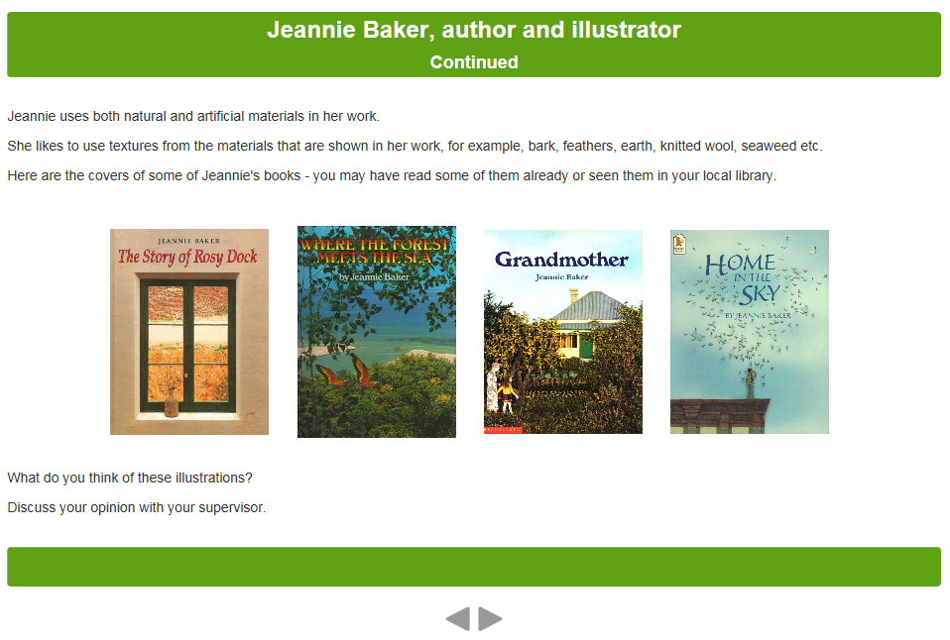
English

Slide 3
Maths

Slide 4
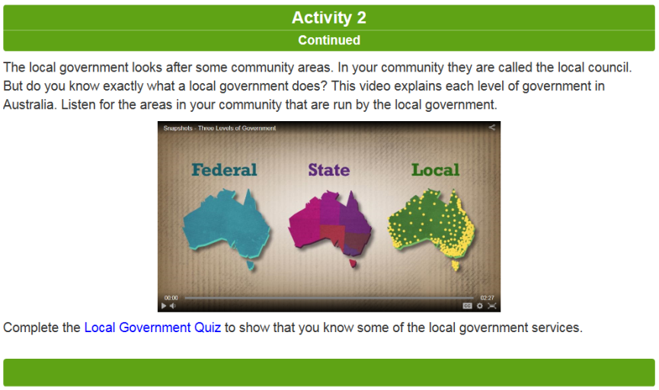
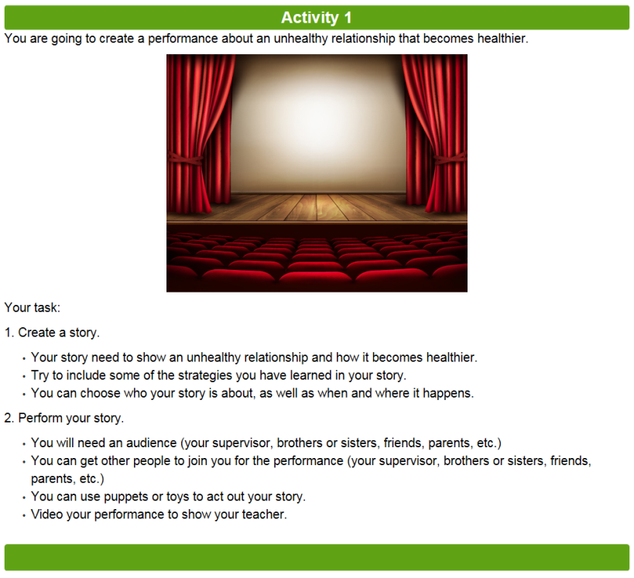
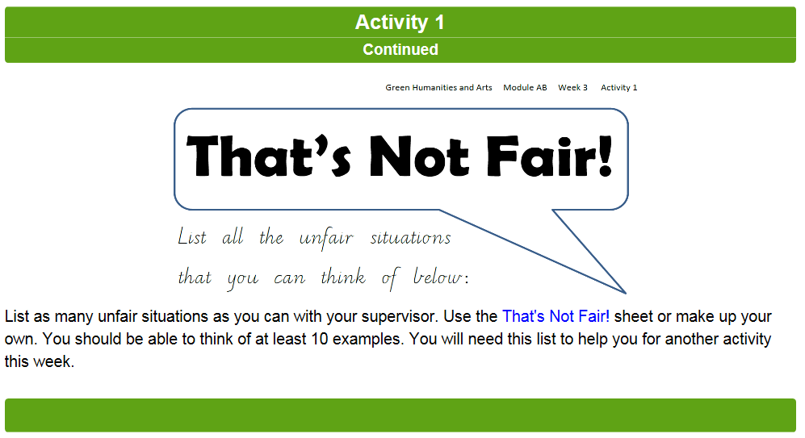
Humanities and Arts History, Civics and Citizenship, Visual Arts, Media Arts, Dance, Drama and Music

Slide 5
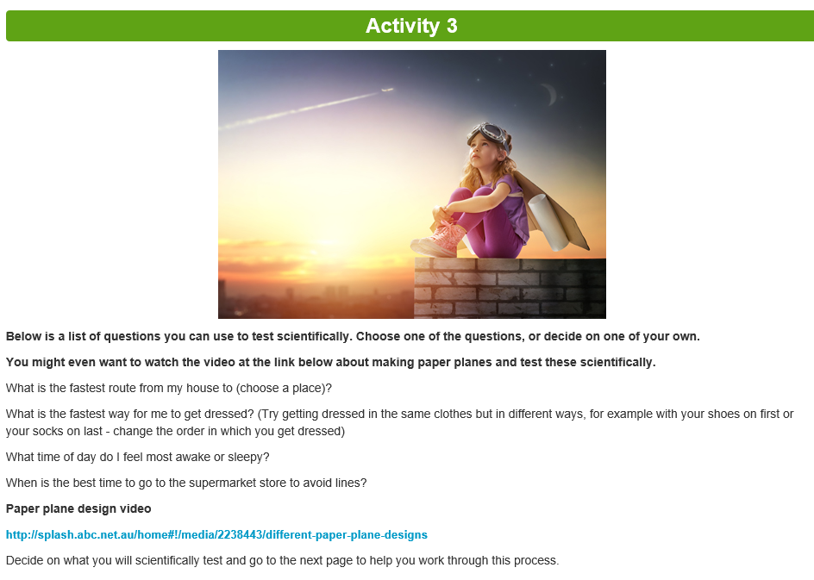
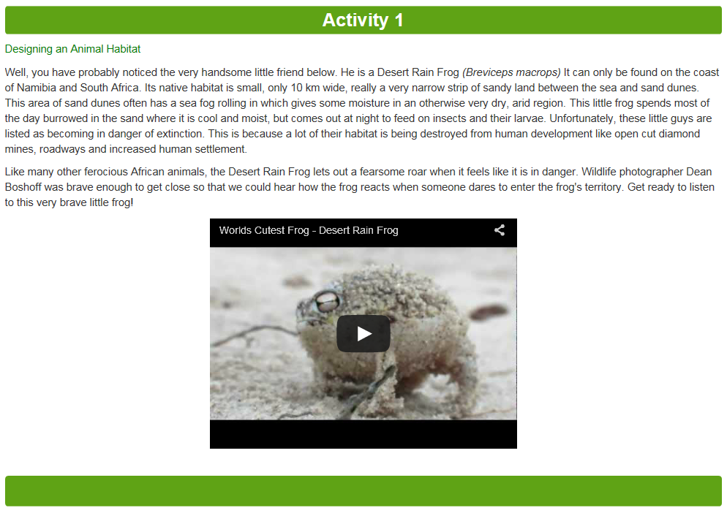
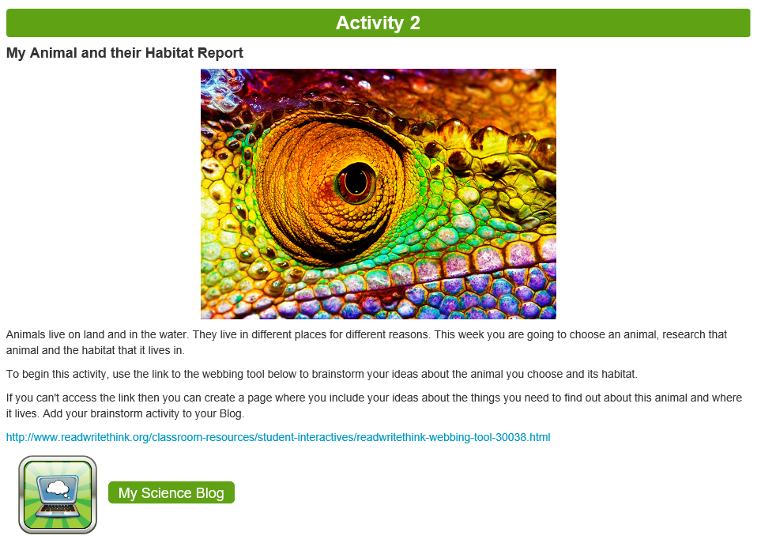
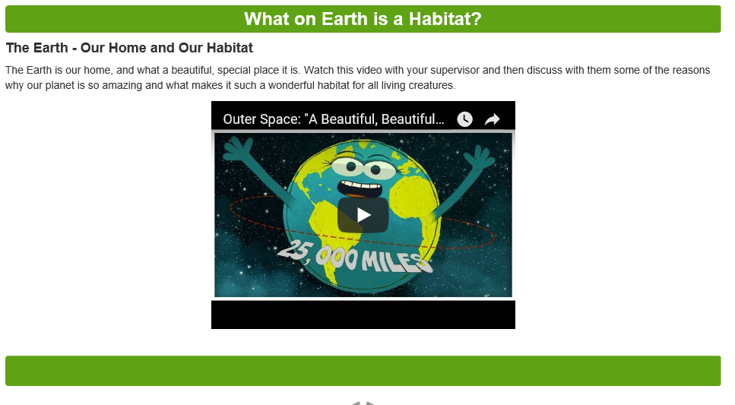
Science, Design and Technologies

Slide 6
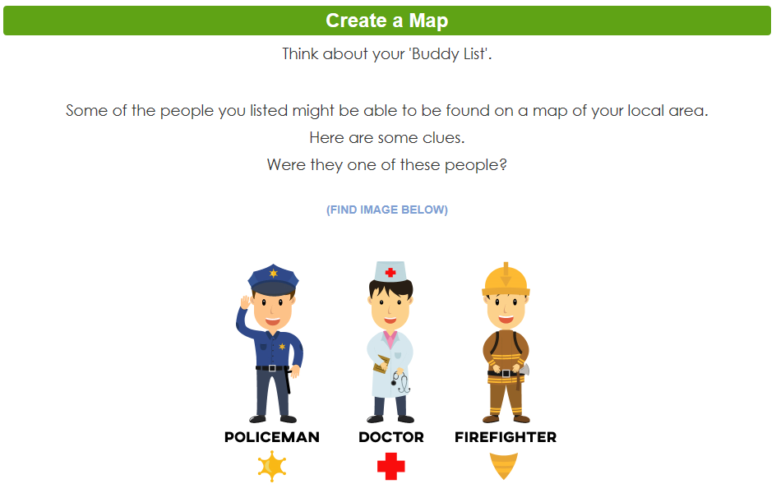
Health and Physical Education

Slide 7
There are many interesting learning activities!

